Slide 1
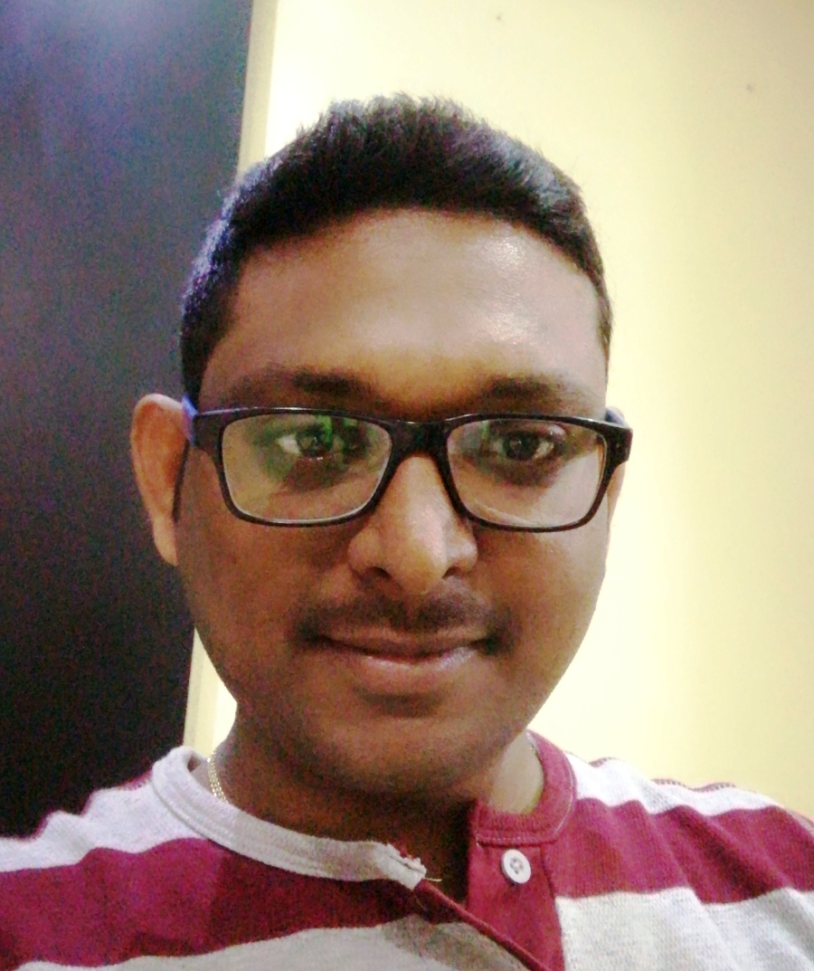
NAME: RAMESH DUTT C
Profile
6 + Years of experience in Development , Production Support.
Over 1+ Years of progressive, professional experience in DevOps and Software Configuration Management which includes Build setup, Continuous Integration, Source Code Management process setup in an Agile methodology.
5 Years I have worked on AS400 /RPGLE/ DB2
Hands on Experience in DevOps tools like Git, GitHub, Maven, Jenkins, Docker, Ansible.
Experience in using source code management tool GIT.
Experience in using build tool Maven.
Hands on experience in Automation of build process (Build Automation) using the Git, Maven and Jenkins.
And monitoring Jenkins batch jobs, deploying code changes into Production environment and master slave configuration.
Wrote Ansible Playbooks, Modules and utilized community Playbooks as well for to deploy application changes into tomcat.
Deploying the JAR and WAR into Tomcat Application Server.
Knowledge in creating docker images, docker containers and written some dockerfiles.
Good interaction with developers, managers, and team members to coordinated job tasks and strong commitment to work.
Knowledge on bug tracking tools such as Kanban, JIRA.
Ability to learn new technologies quickly.
Technical Lead,
Mobile No 9940146356
Email Address::
Rameshdutt.chattakonda@cognizant.com
Core Competencies
Education
DevOps Tools Jenkins, Maven, Git, Docker, Ansible.
Linux
As400, RPGLE
B. E Computer Science
5 Years of Experience in AS400 Development and Production Support.
1 Year of Experience in Jenkins
Client facing experience in daily conference calls.
Good communication
Strength /
Accomplishments

